Slide 1
R building model

Slide 2
R Software Packages
Hmisc: Functions for data analysis, high-level graphics, utility operations, computing sample size and power, importing datasets, imputing missing values, advanced table making, variable clustering, character string manipulation, conversion of S objects to LaTeX code, and recoding variables
rms: Functions for regression modeling, testing, estimation, validation, graphics, prediction, and typesetting by storing enhanced model design attributes in the fit. rms is a collection of 229 functions that assist and streamline modeling, especially for biostatistical and epidemiologic applications

Slide 3
R Software Packages
library(foreign)
library(caret)
library(car)
library(nlme)
library(rms)
library(e1071)
library(BiodiversityR)
library(moments)

Slide 4
Import data
#data <- read.csv(file.choose())
data <- read.csv("*/model.csv")
R modelling tutorial
https://github.com/jinfuchen/R-model
Notes:
# Load data into data frame ‘ data ’

Slide 5
Dataframe handle
1. dplyr
filter, select, group_by, join, summarise, ddply
2. tidyr
gather, spread, separate, unite
3. ggplot2
ggplot, geom_abline, geom_point, geom_histogram
http://hadley.nz/

Slide 6
1.Examine data
names(data) #查看属性
summary(data) #查看分布
skewness(data$post_bugs) #数据倾斜性
kurtosis(data$post_bugs) #数据是否满足正太分布
Notes:
the skewness is a measure of symmetry. As a rule, negative skewness indicates that the mean of the data values is less than the median, and the data distribution is left-skewed. Positive skewness would indicate that the mean of the data values is larger than the median, and the data distribution is right-skewed.
The normal distribution has zero kurtosis

Slide 7
2.Normality adjustment
1.>skewness(data$post_bugs)
[1] 10.36102 #right-skewed
2. > kurtosis(data$post_bugs)
[1] 144.8113 #leptokurtic
3. log transformation [ln(x + 1)] to lessen the skew
log10(data+1)
Notes:
OLS expects that the dependent variable is normally distributed.
If we find that the distribution is skewed, we apply a log transformation [ln(x + 1)] to lessen the skew

Slide 8
3.Estimate Budget for Degrees of Freedom
A critical concern is that of over-fitting. Calculate a budget of degrees of freedom that a dataset can support before attempting to fit a model.
>floor (nrow(data)/15)
[1] 89 #support 89 independent variables
Notes:
Overfitting may creep into models that use more degrees of freedom (e.g., explanatory variables) than a dataset can support.
Hence, it is pragmatic to calculate a budget of degrees of freedom that a dataset can support before attempting to fit a model
we budget n/15 degrees of freedom for our defect models, where n is the number of rows
data can support 89 (1,339/15) degrees of freedom.

Slide 9
Drop data
Remove inf data
drop1<-c("comp","subsystem","mean_discussion","mean_revspeed")
data <- data[,!(names(data) %in% drop1)]
Drop class data
drop2 <- c("post_bugs")
independant <- data[,!(names(data) %in% drop2)]
Notes:
###drop categorical and data with inf

Slide 10
4.Correlation analysis
correlations <- cor(independant, method="spearman")
#spearman or pearson
highCorr <- findCorrelation(correlations, cutoff = .75)
low_cor_names <- names(independant[, -highCorr])
low_cor_data <- independant[(names(independant) %in% low_cor_names)]
Notes:
计算属性关联性
可以选择不同的计算方法，一般使用皮尔逊和斯皮尔曼

Slide 11
Variable clustering analysis
Variable clustering analysis to construct a hierarchical overview of the correlation among the explanatory variables
vcobj <- varclus( ~., data = independant, trans ="abs")
plot(vcobj)
abline(h=1-0.75, col="red")
Notes:
聚类，直观地看各个属性之间的关联性

Slide 12
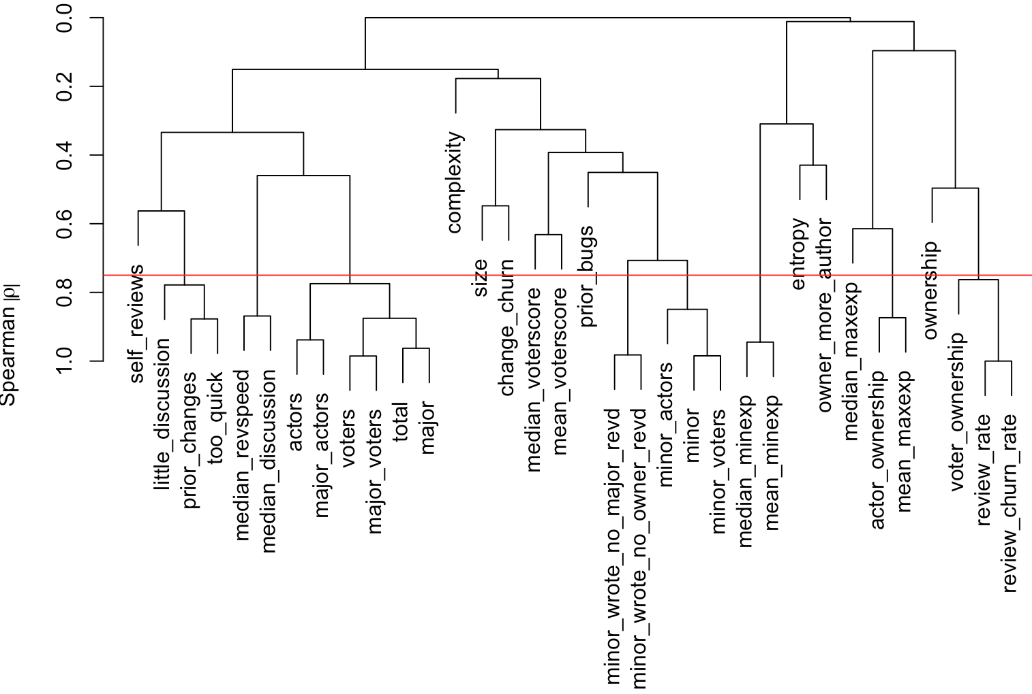
Variable clustering analysis
Notes:
聚类，直观地看各个属性之间的关联性
variable clustering analysis to construct a hierarchical overview of the correlation among the explanatory variables

Slide 13
Redundancy analysis
The redundancy analysis would consider a metric redundant if it can be predicted from a combination of all other metrics.
dataforredun <- low_cor_data
redun_obj <- redun(~. ,data = dataforredun ,nk =0)
after_redun <- dataforredun[,!(names(dataforredun) %in% redun_obj)]
Notes:
We calculate the R2 of each model and if the R2 is largerthan a threshold (0.9) [49], the current dependent variable is
considered redundant.

Slide 14
Model building
Linear model
form<-as.formula(paste(“post_bugs~”, paste(names(after_redun), collapse="+")))
fit <- lm(form, data = log10(data+1) , x=T ,y=T)
Notes:
y = β0 +β1x1 +β2x2 +···+βnxn

Slide 15
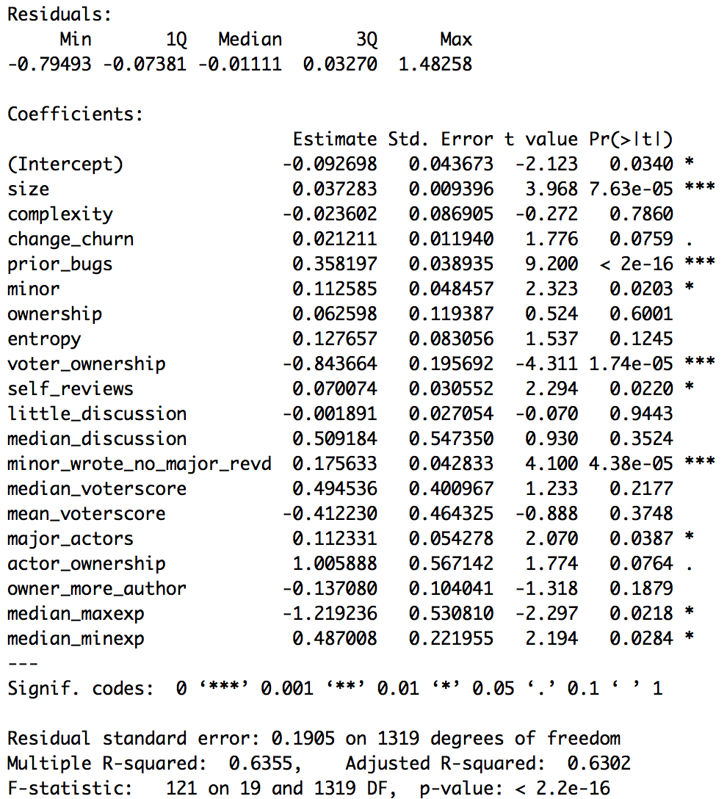
summary(fit)
Notes:
y = β0 +β1x1 +β2x2 +···+βnxn
线性回归方程的显著性检验
T检验，检验模型中某个自变量Xi是否和Y有显著性的相关关系
从回归系数的最后一列，可以去除对建立模型不显著的自变量，重新拟合模型，检验新模型会不会拟合的更好
F检验，检验所有的自变量作为一个整体和Y的线性关系是否显著
R平方相关系数检验，用来判断回归方程的拟合程度，越接近1表示越好的拟合结果

Slide 16
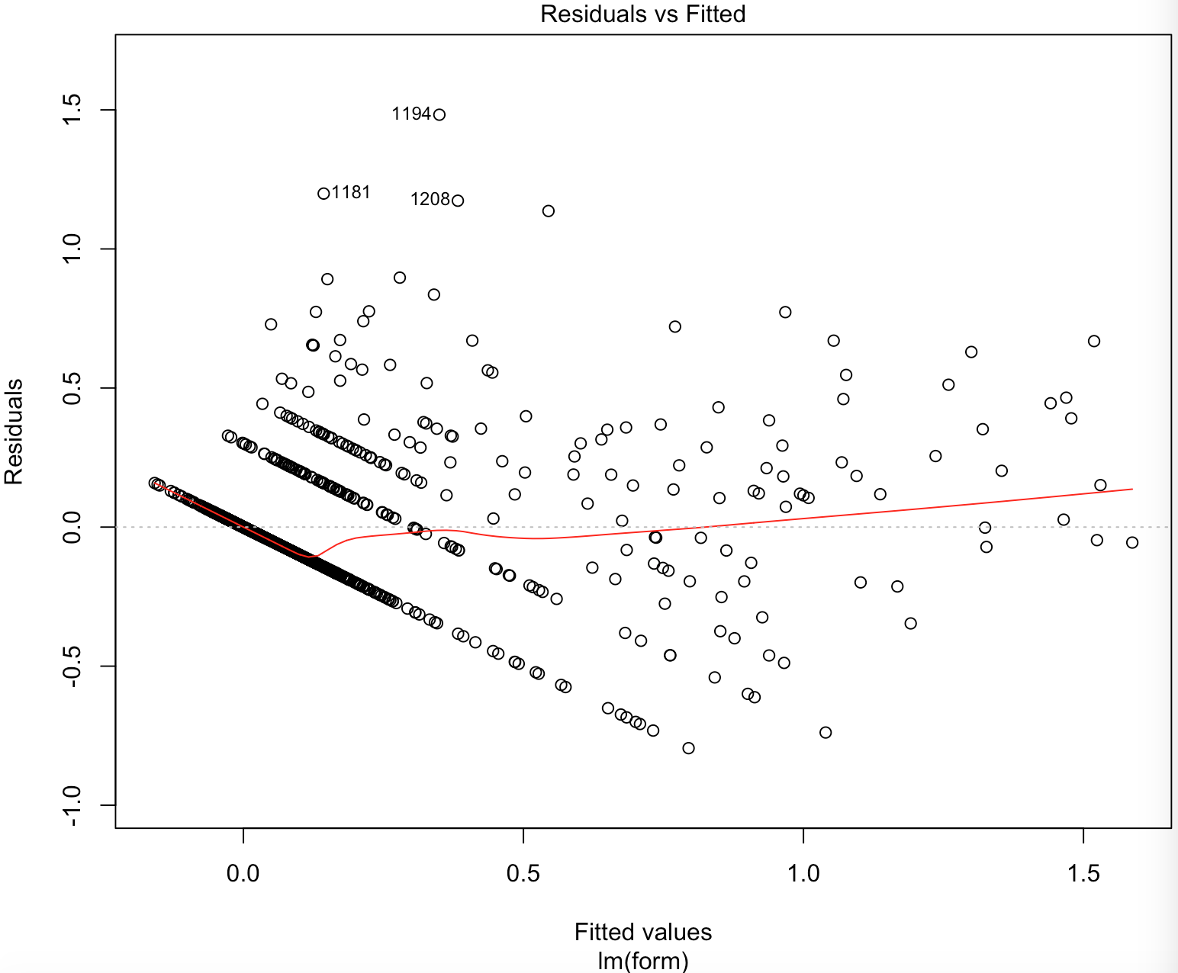
plot(fit)
Notes:
横坐标是拟合值，纵坐标是残差值，红线比较平稳均匀分布在y=0的两侧，说明残差数据很好

Slide 17
Model building
Why RandomForest?
rf.fit <- randomForest(x=after_redun, y=data$post_bugs, ntree=500, importance=TRUE)

Slide 18
Model validation
predictions <- predict(rf.fit, data, type="response")
TP <- sum((predictions>0.5) & (data$post_bugs>0))
precision <- TP/sum((predictions>0.5))
recall <- TP/sum(data$post_bugs>0)
Notes:
External validation using new test data generated using different instruments, done by an independent research team

Slide 19
Model more…
xgboost

Slide 20
AUC
data imbalanced
data is highly skewed since the majority of the tests do not manifest performance regression.
The AUC is the area under the ROC curve which indicates the performance of a binary model as its discrimination is varied.

Slide 21
AUC
Model validation
model_roc <- roc(test_data$post_bugs>0,predictions)
auc <- auc(model_roc) #0.8462

Slide 22
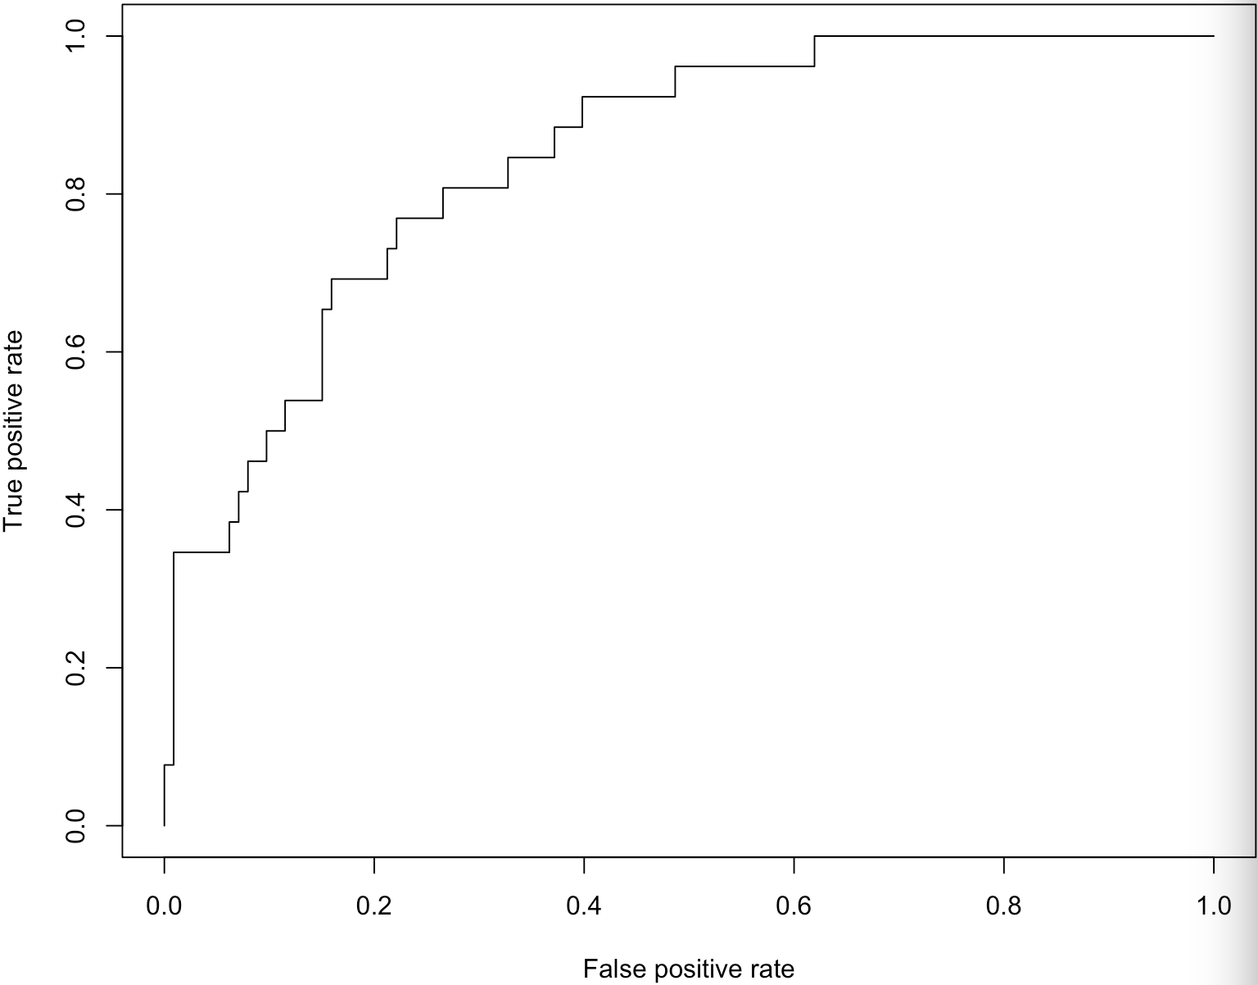
AUC
Notes:
TPR (Sensitivity敏感度)：True Positive Rate（正例覆盖率），将实际的1正确地预测为1的概率
FPR (1-Specificity误判率): False Positive Rate，将实际的0错误地预测为1的概率
希望能够使TPR尽量地大，而FPR尽量地小。影响TPR与FPR的重要因素就是“阈值”

Slide 23
Assessment of model stability
Validate model fit using resampling
num_iter <- 100
validate(fit, B=num_iter)
# Run the bootstrapped optimism calculations

Slide 24
Estimate power of variable
anova(fit , test ="Chisq")
Example
fit <- glm(y~x1+x2+x3),family=”binomial”)
Running
1.glm(y~1, family=”binomial”) vs. glm(y~x1, family=”binomial”)
2.glm(y~x1, family=”binomial”) vs glm(y~x1+x2, family=”binomial”)
3.glm(y~x1+x2, family=”binomial”) vs glm(y~x1+x2+x3, family=”binomial”)
Notes:
The larger the Wald chi χ2 value, the larger the impact that a particular explanatory variable has on a model’s performance.

Slide 25
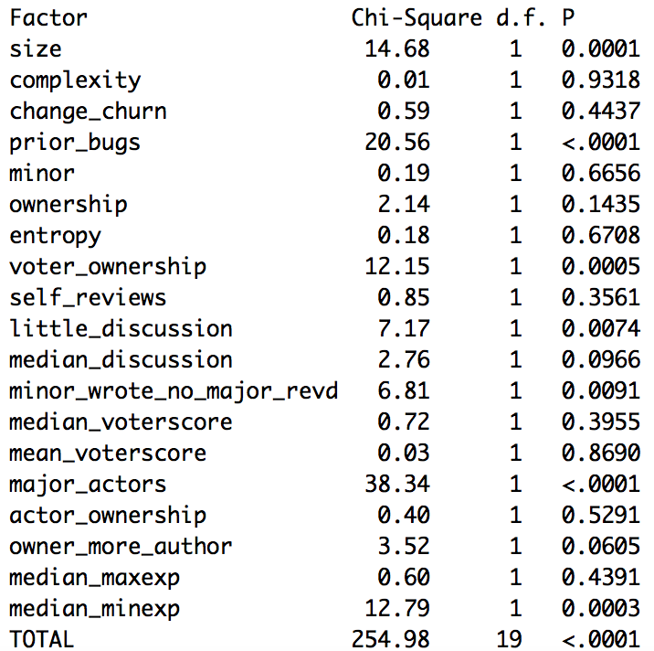

Slide 26
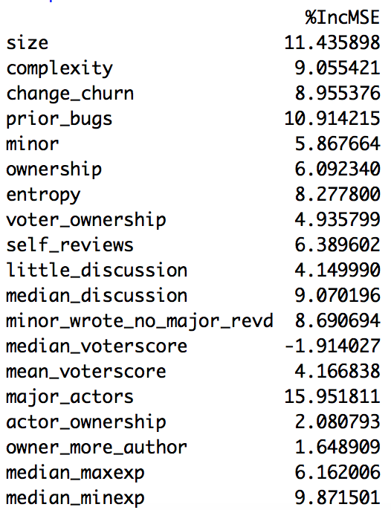
Estimate power of variable
importance <- importance(rf.fit, type=1)
Notes:
IncMSE (increased in mean squared error)越高，这个变量越重要. 控制其他变量的值不变，只变其中一个变量的值
IncNodePurity, 节点纯度，基于Gini指数，值越高属性越重要

Slide 27
data rebalance
Up-sampling
oversample_data <- upSample(x=x_data, y=y_data, yname="post_bugs")

Slide 28
data rebalance
SMOTE
form <- as.formula(post_bugs~.))
smote_data <- SMOTE(form, data = data, perc.over = 1000, perc.under = 150)
perc.over = i #少样本变成原来的(1+i/100)倍
perc.under=k #多样本变成少样本的k/100*(i/100)倍

Slide 29
Hypothesis test-significant difference
Compare mean
T-test
Compare order
wilcox-test
Compare distribution
ks-test
…

Slide 30
Effect size-How big difference?
cohen.d
Cliff’s delta

